Slide 1

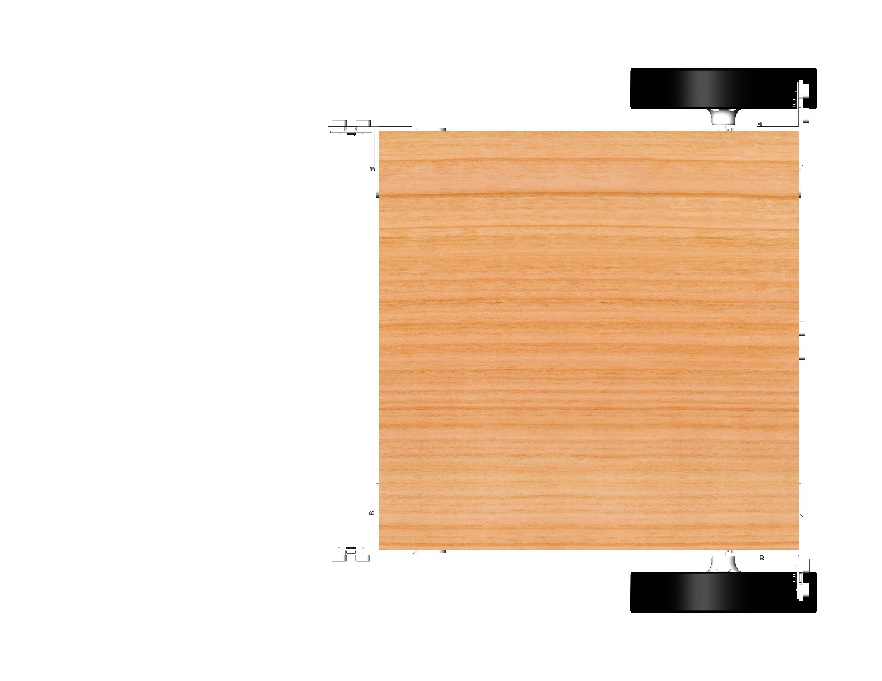
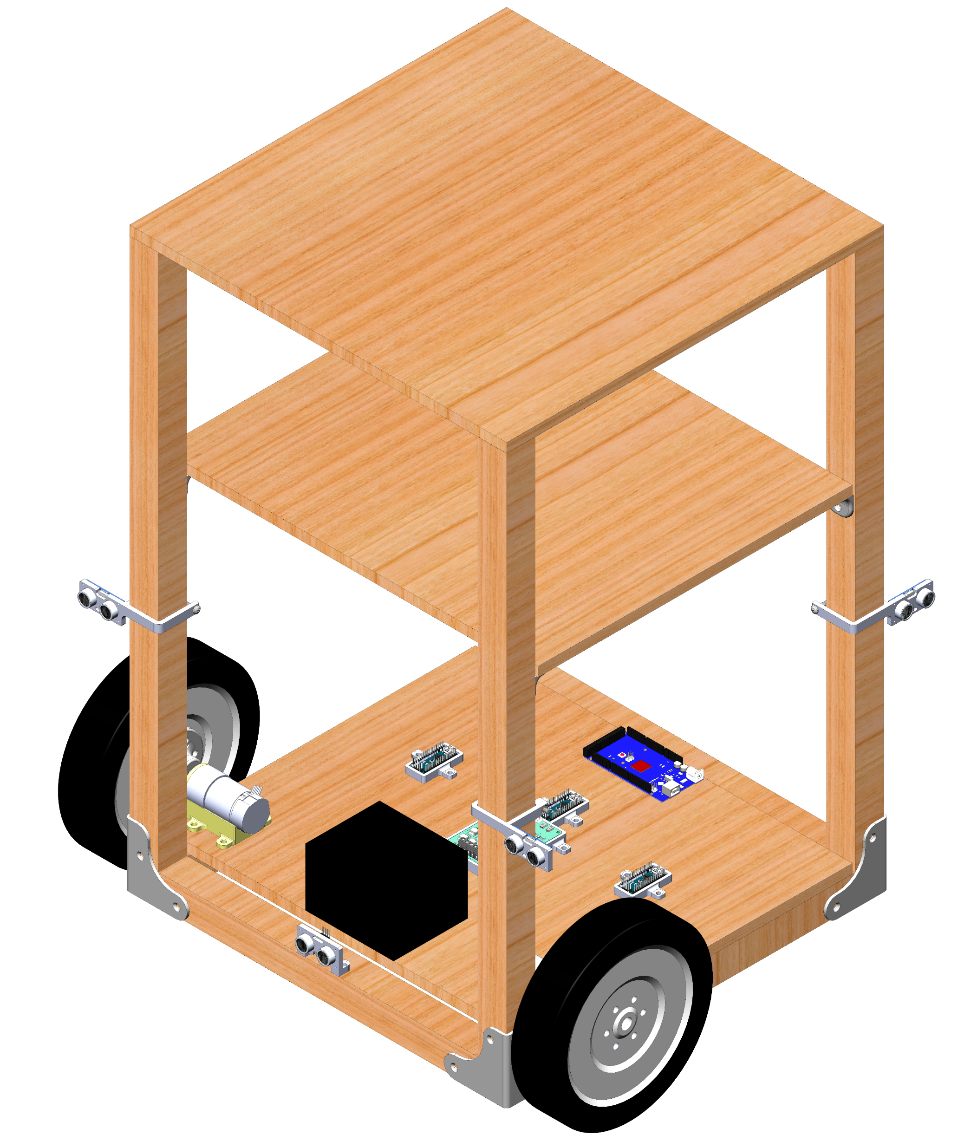
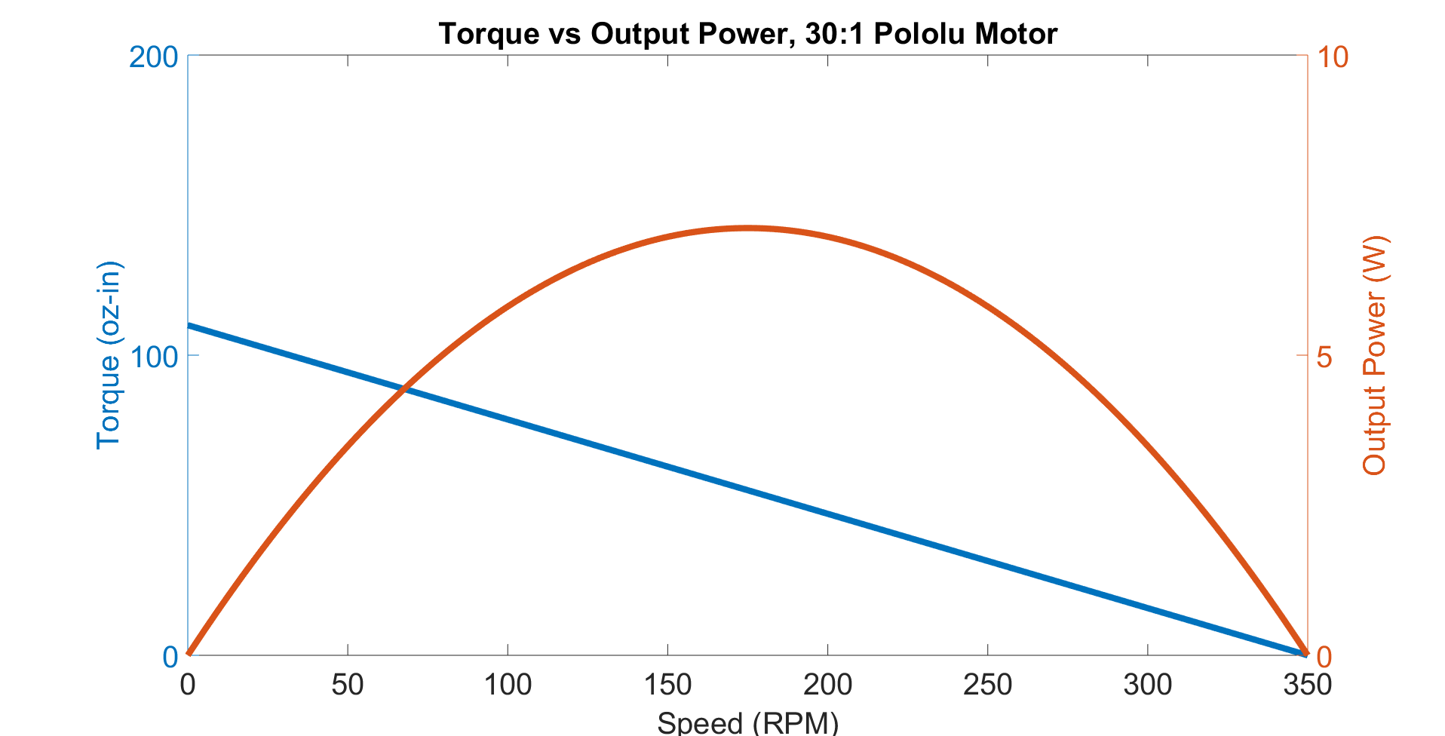
Design and Prototype of an Autonomous Shopping Cart
Siddharth Kurwa, Cockrell School of Engineering, siddharth.kurwa@gmail.com, Fall 2018
Background
Control System Architecture
Obstacle Avoidance Logic
Since the invention of the first shopping cart in 1937, there have only been modest updates to the device design driven by innovation in materials and manufacturing processes. With modern advances in sensing and mechatronics, the shopping cart is prime for a redesign that leverages these technologies.
Disturbance
+
+
PID
Left Motor
+
-
-
5
Project Goals
Proximity Sensor Array
Setpoint Selector
Encoder Feedback
4
6
This project’s goal was to build a functional prototype of a motorized cart with storage volume and the capacity to avoid and navigate around obstacles. This system will serve as a platform to develop, prototype, and test features towards a fully-fleshed autonomous shopping cart.
Fully implemented, an autonomous shopping cart will consist of the following features:
Offers storage volume comparable to standard shopping carts
Motion plans around obstacles
Follows shopper around store
Automatically scans items placed into the cart
Provides a payment terminal for shopping
+
PID
Right Motor
-
3
Encoder Feedback
Obstacle
7
Gyro Feedback
2
8
1
9
Closed-loop speed control is achieved with encoder feedback of each motor. However, motor speed differential is insufficient to determine heading of the system in slip conditions. Therefore, a gyro provides closed-loop heading control.
Mechanical Design
[TO DO: PID TUNING IMAGES]
Cart approaches obstacle and forward proximity sensors detect obstacle.
Cart performs a 90° turn using gyro feedback.
Cart moves forward until rear right proximity sensor crosses obstacle.
Cart performs a -90° turn using gyro feedback.
Cart moves forward until rear right proximity sensor crosses obstacle.
Cart performs -90° turn using gyro feedback.
Cart moves forward until rear right proximity sensor detects obstacle.
Cart performs a 90° turn using gyro feedback.
Cart moves forward along initial path.
Grocery storage
Conclusions and Future Work
Motor driver
Arduinos
The functional prototype demonstrates the basic features required of a fully-functional autonomous shopping cart. The primary project goals have been achieved as the system is capable of performing obstacle avoidance, carrying groceries, and carries sufficient onboard processing power to enable further testing of further features.
Improvements to make to the existing system:
Add a bearing block between the motor and wheel hub. This additional support will reduce the bending moment and shear load that the motors currently react and increase the maximum load-bearing capacity.
Mount ultrasonic sensors on a continuous servomotor or use LiDAR to provide 360° proximity detection. In the existing system, there are several “blind-zones” that are not monitored for potential obstacles.
Develop and implement more functional avoidance algorithms to allow smoother path-planning around obstacles rather than the combination of 90° turns and straight-line motion.
New features to incorporate:
Investigate indoor localization sensing capabilities. Several off-the-shelf options exist including PixyCam, Bluetooth transmitters/receivers, and Wi-Fi.
RFID sensors and onboard payment terminals to enable monitoring of items in the cart and simplify the payment process.
To tune the motor PID controllers, the Ziegler-Nichols tuning method was applied. This method is procedure to experimentally estimate optimal PID parameters (K_{P}, K_{I}, and K_{D}) to maximize response time, eliminate steady-state error, and maintain system stability.
Distributed Computing over I²C Network
DC gearmotor
Proximity sensor measurement and setpoint determination,
Arduino Nano (slave),
Polling at 4 Hz
Sealed lead acid battery
Ultrasonic proximity sensors
Wheel velocity setpoints
The wheel base was modeled on a differential drive robot with one driven caster and two driving wheels. The controllers, power storage, and drive units are all stored on the bottom platform to maximize usable grocery storage volume. This functional prototype has a wooden construction and uses 3D-printed brackets, fixtures, and mounting adapters.
PID controller,
Arduino Mega (master),
Polling at 50 Hz
Measured
velocity
Measured
velocity
Left wheel drive signal
Right wheel drive signal
Acknowledgements
Left wheel velocity measurement and motor drive,
Arduino Nano (slave),
Interrupt-based
Right wheel velocity measurement and motor drive,
Arduino Nano (slave)
Interrupt-based
I deeply appreciate Dr. Carolyn Seepersad’s support of this project. Her advice and feedback were beneficial to the completion of this project.
Further Information
At a normal walking speed, each encoder clicks at a 3500 Hz frequency. Further, each proximity sensor requires a minimum 50 ms delay as its operation is limited by the speed of sound. If these tasks were handled serially by a single controller, the PID loop rate would be extremely limited by the high controller transport delay. To improve dynamic system stability and response time with changing setpoints, computational tasks were distributed over 4 Arduino microcontrollers and communicated over I²C protocol. By managing tasks in parallel to minimize transport delay, the system achieved a 50 Hz PID loop rate.
CAD, source code, BOM, documentation: https://github.com/skurwa/smart-cart
To learn more about Sid: https://skurwa.github.io
Based on torque-speed analysis, the DC gearmotor was appropriately sized to handle torque loads based on a 25 lb cart load, human walking speed (5 ft/s), 1 ft/s² acceleration, a 0.25° incline, and 70% efficiency.
References
Zafari, F., Gkelias, A., & Leung, K. K. (2018). A Survey of Indoor Localization Systems Technologies
(Rep. No. 1709.01015). https://arxiv.org/pdf/1709.01015.pdf

